Slide 1

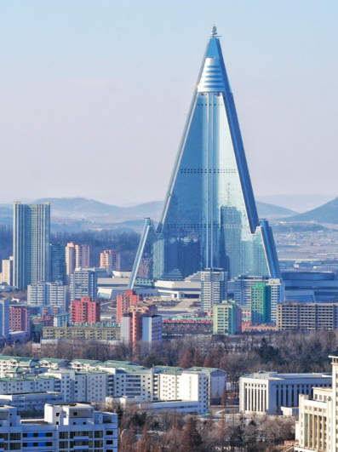
North Korea
A Global Citizenship Case Study
By: Lachlan Mcmahon and Lachlan Mackay:
Class: Citizenship 9
Issue: Nuclear Weapons and Isolation

Slide 2
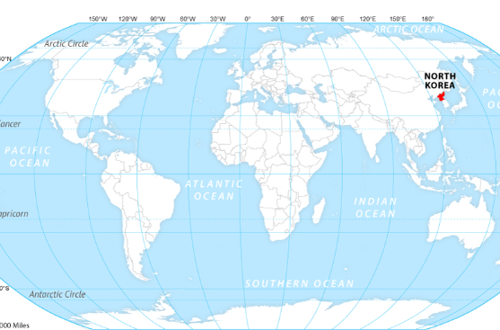
Country Profile: North Korea
Who Are They, Where Are They, What's it like
Geography - North Korea is located in Asia, above South Korea, and borders the Pacific ocean.
Culture - North Korea has a VERY unique culture, where you must praise their leader, Kim Jong Un and but his pictures above your own life. And if you don't obey him a praise him, you will be killed.
Economy - Since the population is heavily isolated, and controlled, Kim is heavily focused on mass militarization, thats where majority of funds end up going. This also leads their country to have chronic food shortages, as theirs such strict rules of going in and out.
Company Name
Quarter Month
Year

Slide 3
The Issue: Nuclear Weapons & Isolation
Why is Nuclear Weapons & Isolation a problem?
Why is North Korea’s Nuclear Weapons a problem?
SInce Kim Jong Un puts so much of their country's funds into the military, it's no shocker that they have nuclear weapons and devices. North Korea's nuclear program is classified as a “Global Security Crisis” because of the limited communication that comes from North Korea, meaning we don't know exactly how much nuclear threats they have and don't know what their plans are with them. Since we knows minimal things about their nuclear tools, other governments have initiated “heightened threats” protocols and are ready just incase North Korea tries things.
Why is Isolation a problem?
North Korea's isolation is a global issue for 2 main reasons that connect with each other. Number 1 is when they are making their heavy nuclear weapons as we discussed to the left, we have no way of knowing how safe they are or anything like that. We also cant put any safety measures on them because we don't know what they are doing to make them or how they are making them. Another reason is because since there is no way to check if human right laws are being violated over there. This means we will never know how sever things are over there for the people, and likely will never be able to.
Company Name
Quarter Month
Year

Slide 4

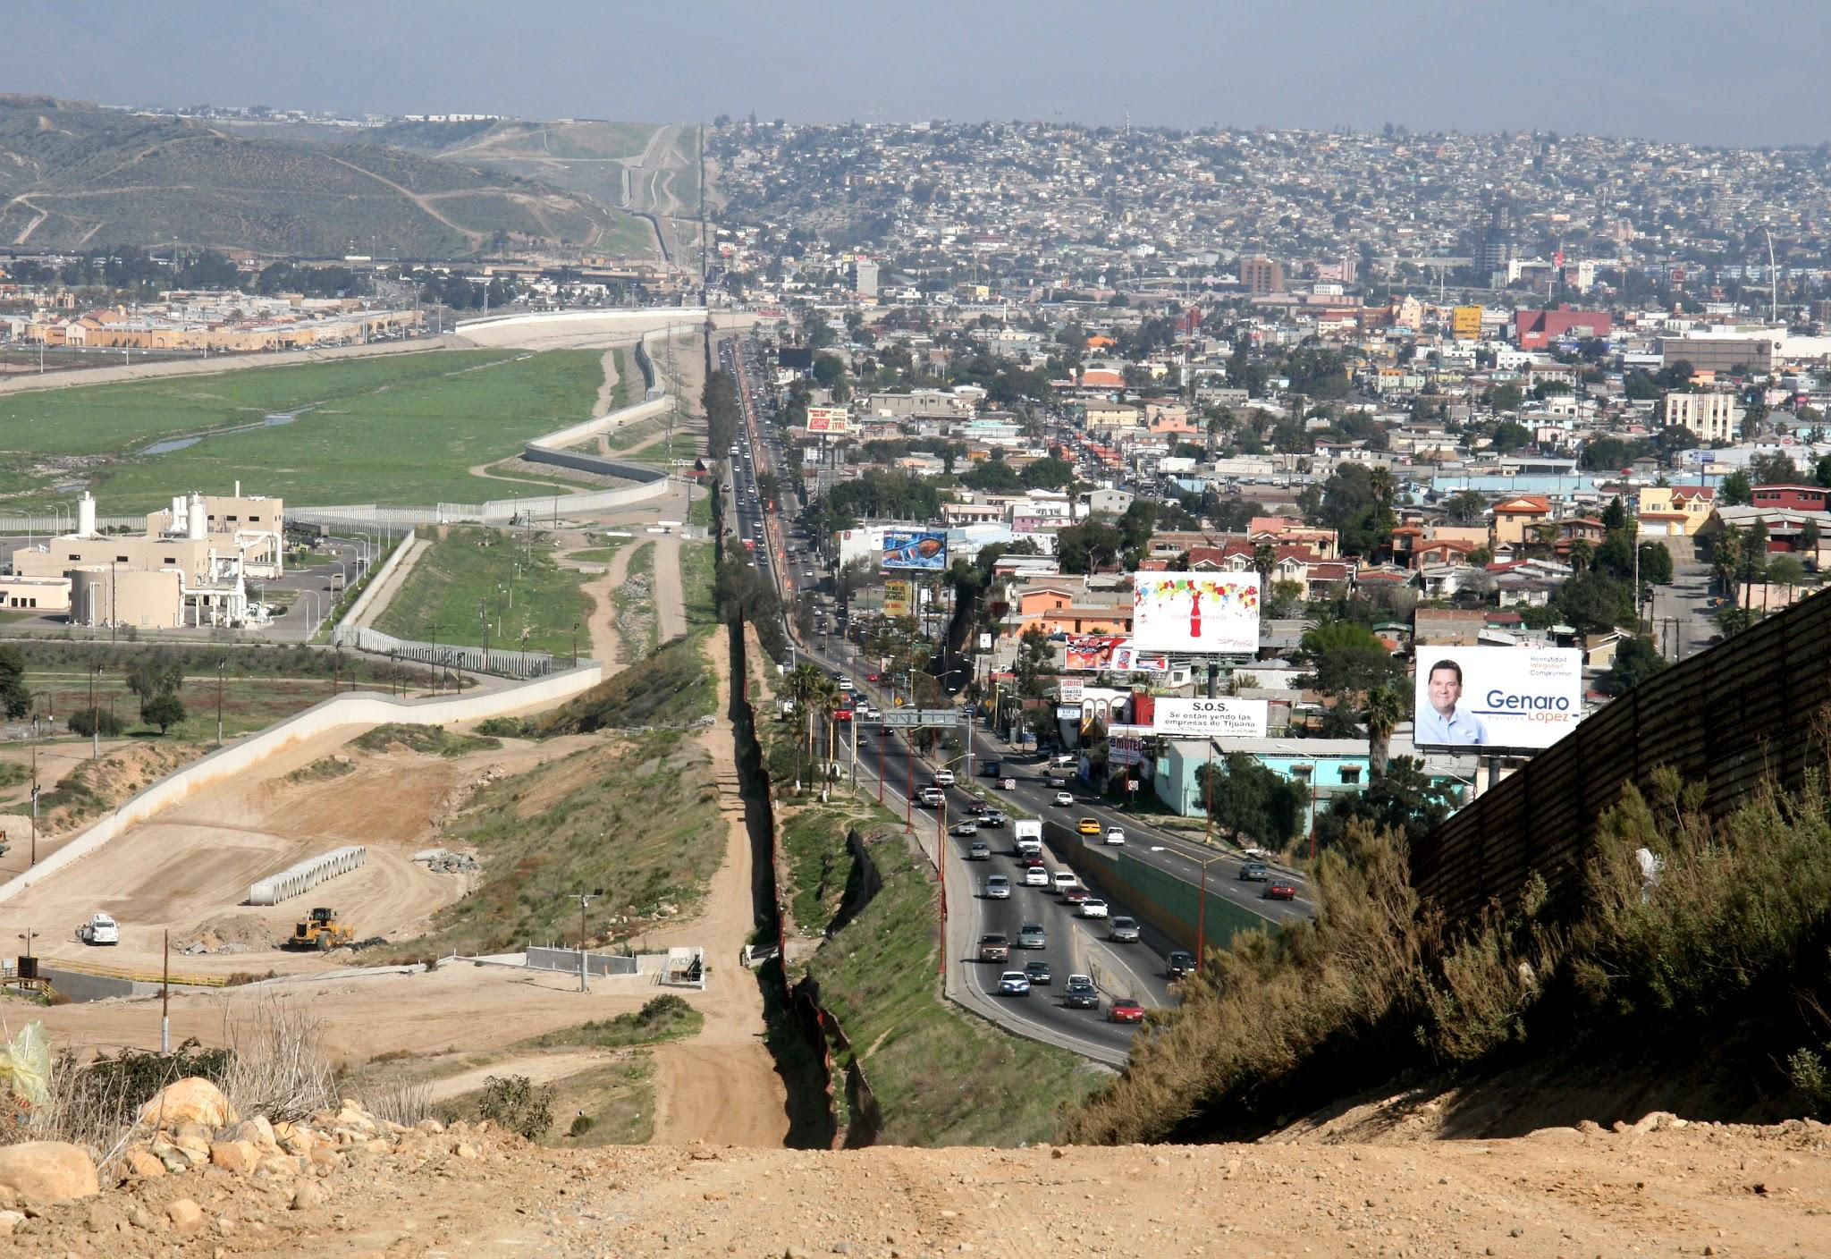
Actions
North Korea's goal isn't to fix their corrupt country, their goal is to keep it the same, but trick other countries into believing its not corrupt, Kim Jong Un has taken actions by attaching ties with asian countries such as vietnam and Indonesia. The only reason these countries agree to spread the good words about North Korea is because they are promised better healthcare and more food and goods. This is an issue for these high population countries, because the people actually believe it and are actually spreading the word. Another action North Korea has done in attempt to get the world off its back, is by reopening the borders to certain Russian and China tourism to get these large countries and large populations to see the “good” in the country, while hiding the bad.
Company Name
Quarter Month
Year

Slide 5
INTENDED CONSEQUENCES
UNINTENDED CONSEQUENCES
Success
Success
Problems
Problems
Gained alliances
Gained population support
Looks like they're hiding something
More potential whistleblowers
With Russia, China, Indonesia, and Vietnam making deals with North Korea to keep quiet about the bad and talk about the good, citizens of those countries are believing it to be the truth
With widespread population, of a total of 4 countries saying North Korea is all good, this is over 1 billion people in total who are being told this, North Korea knows that this is ⅛ of the population, his plan seems to be working.
With all these under the table deals being made to keep quiet, it raises even more suspicious about what really goes on behind those borders, leaving more people to believe it's heavy illegal business, and human rights violations.
The more people you have on your side being told your secret (high ups in China, Indonesia, Russia, Vietnam) the more people there is too spill it. Many things e know about North Korea is through whistle blowers, which Kim can't really stop.
Company Name
Quarter Month
Year

Slide 6
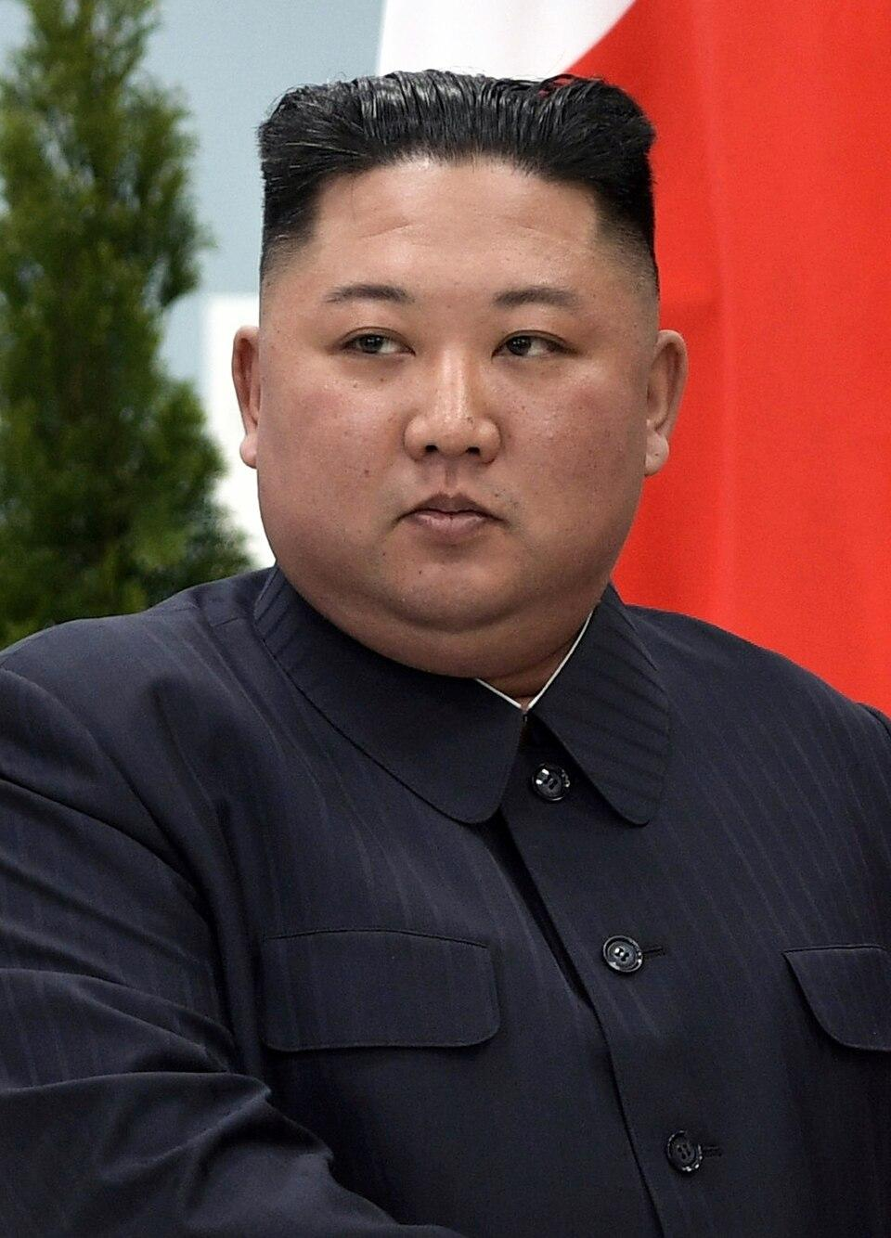
Canada's response to North Korea's action
Canada can't really do all that much for these issues, but we’re doing the best we can. This includes creating international connections with countries all over the world, leaving a trace of security and potential information they may have that can benefit us to protect ourselves. We also have deployed Navy and AIrcraft vessels to monitor any illegal transactions of illegal goods being imported or exported into/out of North Korea. That's the most we can do as we don’t have a lot of power as to stop them or change things

Slide 7
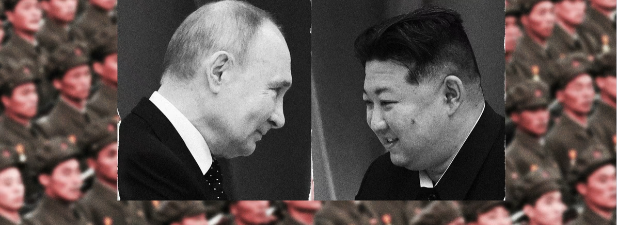
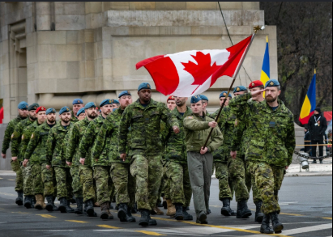
Why Should Canadians Care?
Canadian Concerns
Many Canadians think this is no personal concern to them or their peers, but this is not entirely true. As KIm Jong Un has the unauthorized power to nuclear and military forces that can do dangerous things. He also has a very strong connection to Russia and Putin, and Russia's military is one of the strongest on the globe, so if at anypoint Kim decides he doesn't want us around, or sees us a threat or anything like that, he can grab his biggest alliance, Russia, and they could attempt to attack us. Now Canada has strong alliances, just as strong if not stronger than North Korea's, but it's still a threatening thing to us, that they have such power that we know nothing about.

Slide 8
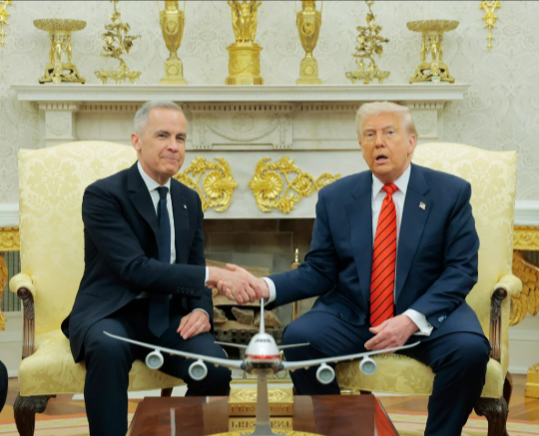
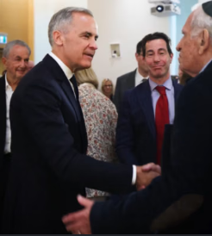
Thank you
https://en.wikipedia.org/wiki/Economy_of_North_Korea
https://en.wikipedia.org/wiki/North_Korea_and_weapons_of_mass_destruction
https://www.cfr.org/global-conflict-tracker/conflict/north-korea-crisis
https://www.investmentmonitor.ai/features/north-korea-global-isolation-investment/
https://www.hrw.org/news/2020/01/14/north-korea-systematic-repression
Company Name
Quarter Month
Year

